Slide 1
Underwater Vehicle

Slide 2
Task Description
Implement a Stochastic Multiple-Model Adaptive Control framework for an underwater vehicle that is compatible with the OceanRINGS+ set of software and hardware tools.

Slide 3
Subtasks
Identify and simulate different operating modes for the underwater vehicle.
Design a single-model feedback control law for the underwater vehicle.
Design and code communication interface between Python and OceanRINGS+.
Tune system level controllers for each operating mode (produce stable control region).
Implement uniform blended control for control mixing.
Implement learning-based blended control.

Slide 4
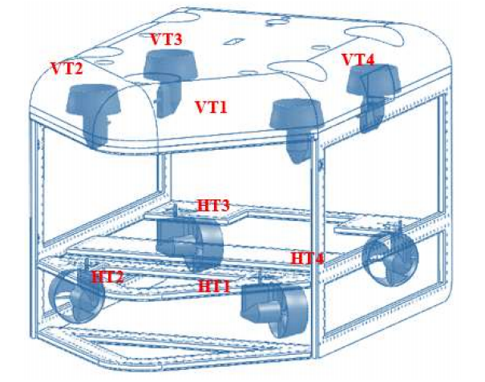
ROV Model
Two layers of thrusters:
Horizontal layer: X, Y, and yaw.
Vertical layer: Z, roll, and pitch.
Six degrees of freedom:
XYZ forces and roll, pitch, yaw torques.
Allocated to 8 thrusters.
Focus only on XY trajectories (no change in depth).
MMAC only for X and Y controllers.

Slide 5
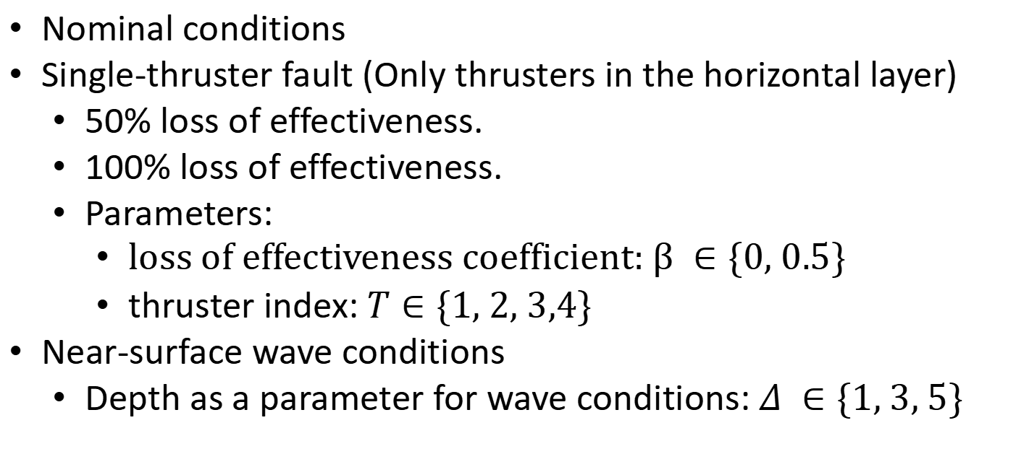
ROV Operating Modes
Nominal conditions
Single-thruster fault (Only thrusters in the horizontal layer)
50% loss of effectiveness.
100% loss of effectiveness.
Parameters:
loss of effectiveness coefficient: $β ∈\{0, 0.5\}$
thruster index: $Τ∈\{1, 2, 3,4\}$
Near-surface wave conditions
Depth as a parameter for wave conditions: $Δ ∈\{1, 3, 5\}$

Slide 6
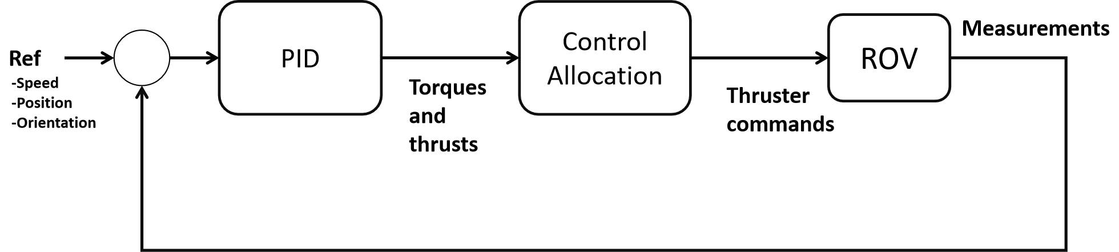
ROV Control. OceanRings+

Slide 7
ROV Control. New Approach
Python-OceanRings+ Interface
New Control Law
Python-OceanRings+ Interface

Slide 8
New Single-Model Feedback Control Law
x_err
v_target
PID
Control Allocation
Measurements
Velocity Curve
ROV
Ref
-Position
Torques and thrusts
Thruster commands
v_target
x_err
*Max Velocity: 2.5m/s
*Min Error: 0.1m

Slide 9
Reference Trajectories
Trajectory Types
Step signal in X, Y, or XY.
Single Waypoint.
Square Trajectory.
Circular Trajectory.
All reference trajectories are in the XY plane.
Z, roll, pitch, and yaw references are fixed.

Slide 10
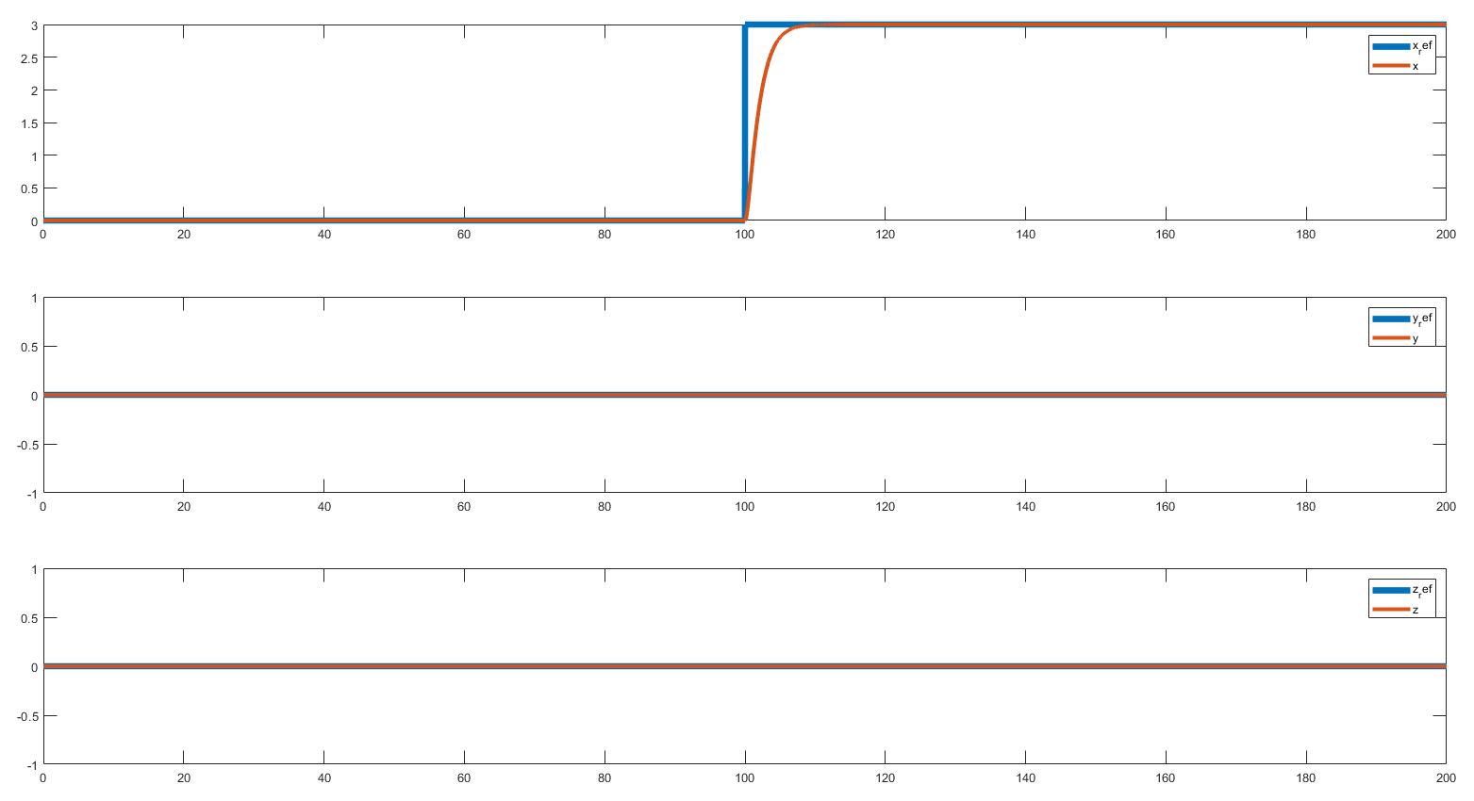
PID Pretuning Using Matlab Simulator
Step in X

Slide 11
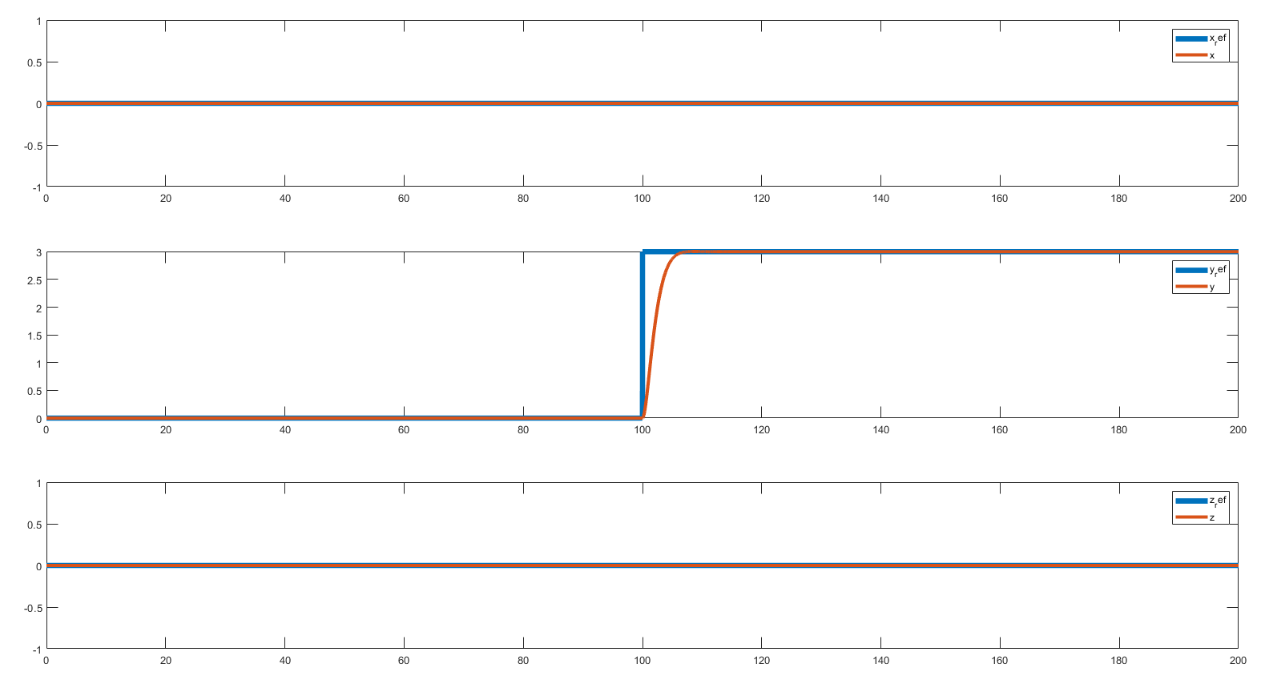
PID Pretuning Using Matlab Simulator
Step in Y

Slide 12
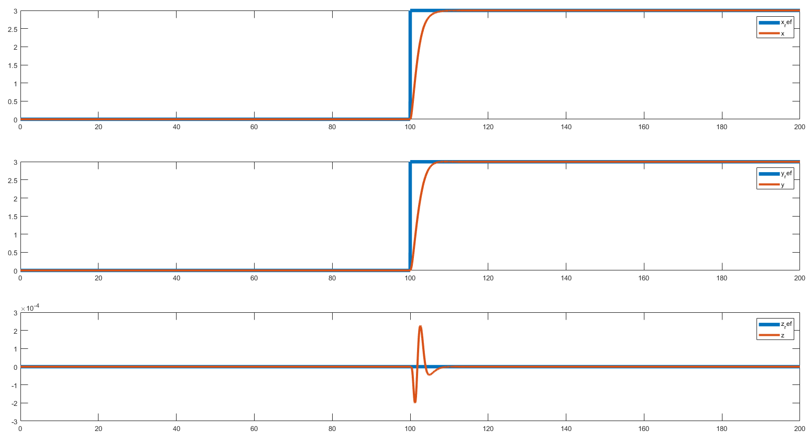
PID Pretuning Using Matlab Simulator
Step in XY

Slide 13
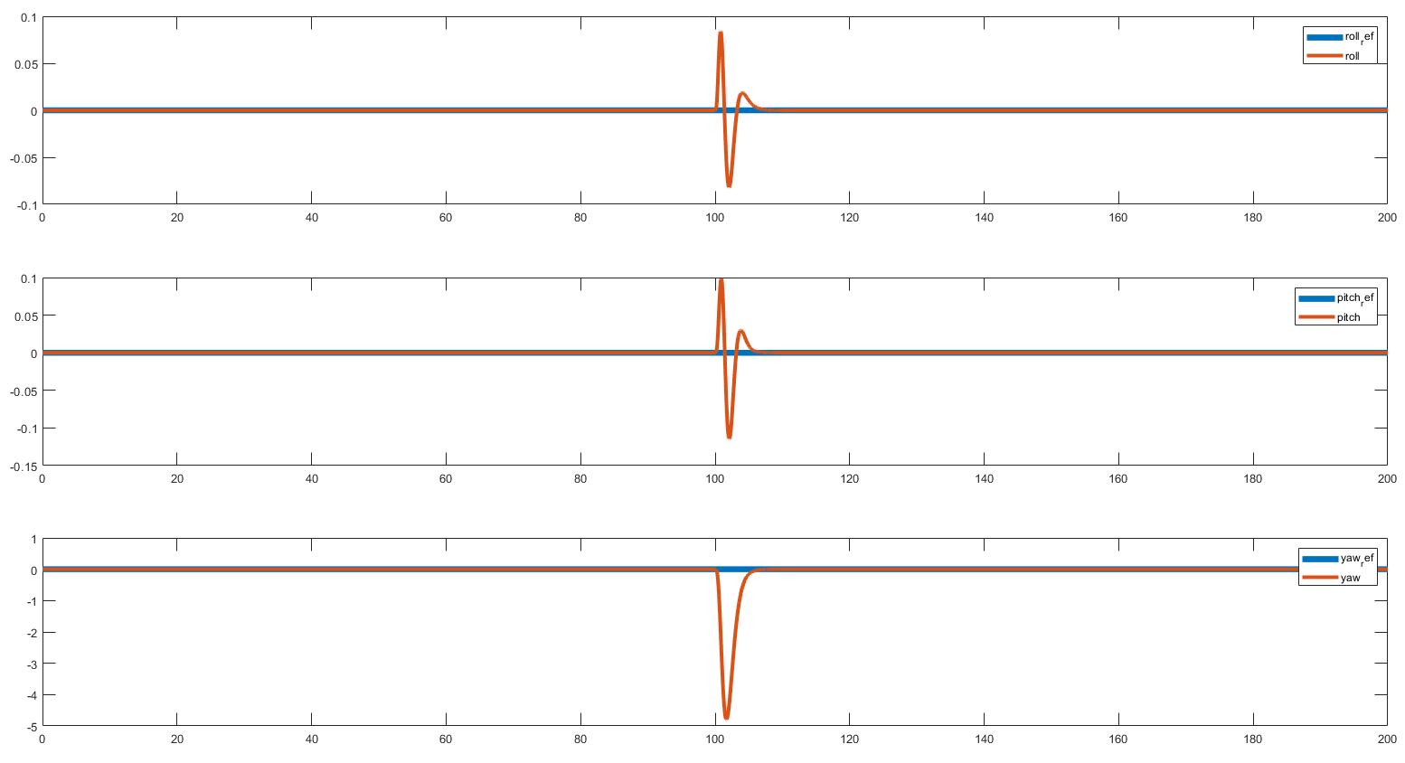
PID Pretuning Using Matlab Simulator
Step in XY (roll, pitch, yaw)

Slide 14
Subtasks
Identify and simulate different operating modes for the underwater vehicle.
Design a single-model feedback control law for the underwater vehicle.
Design and code communication interface between Python and OceanRINGS+.
Tune system level controllers for each operating mode (produce stable control region).
Implement uniform blended control for control mixing.
Implement learning-based blended control.

